Slide 1

Butler Final Project
Group J

Slide 2
Butler Final Project
Sirine Kheilfi
PowerBI/Tableau
Kyle O’Malley
Streamlit/Heroku/ML
Bill Taylor
SQL and other stuff

Slide 3
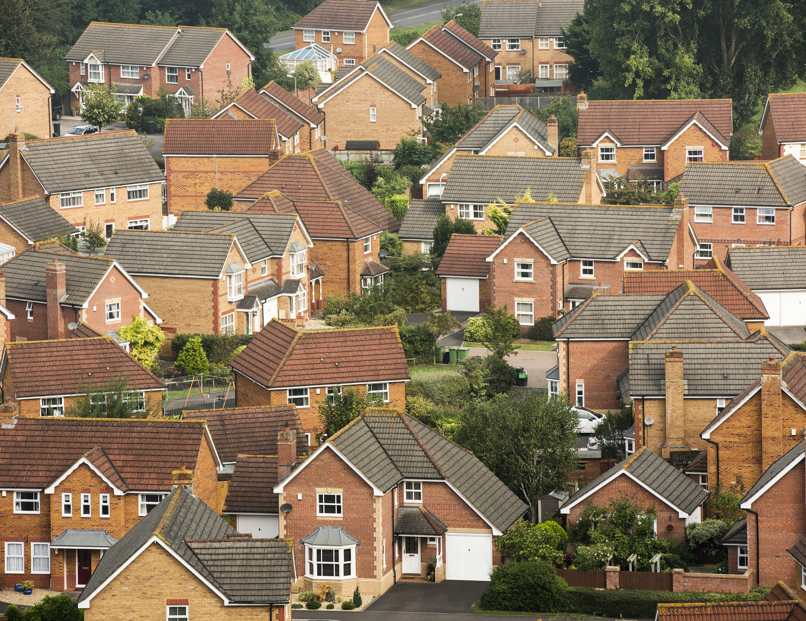
Home Value Predictor
Our problem we developed our app to do is to is using past home values by month, what will the average home value be at some point in the future.
We are limiting the future to 3 years out.

Slide 4
Here is the app!
Add hyperlink here

Slide 5

ETL Steps Taken

Slide 6

Power BI steps and map

